Slide 1
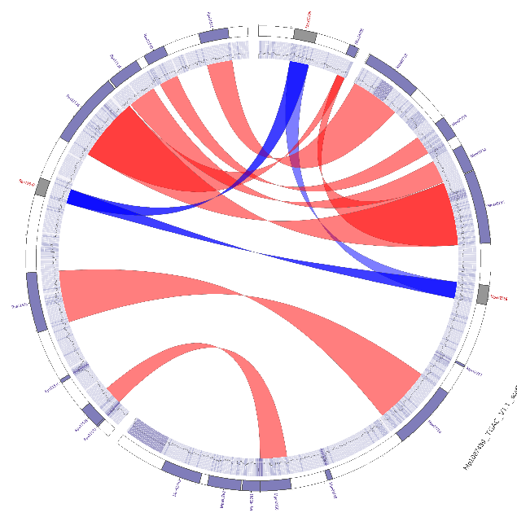
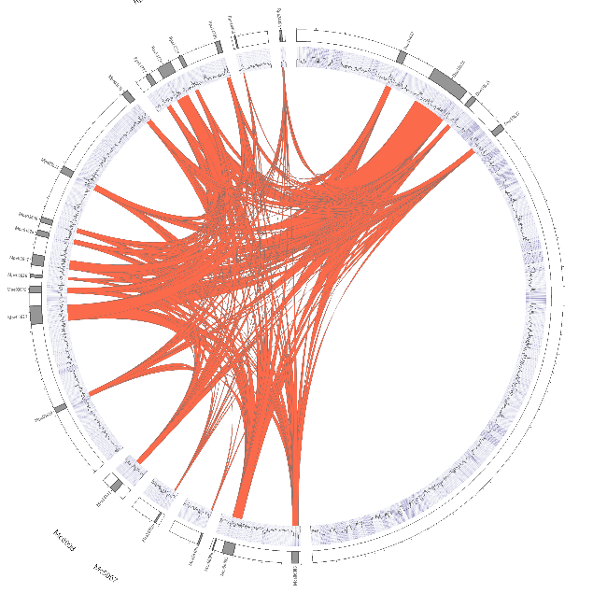
Bioinformatic analysis and its applications University of Dundee – Data analysis group Peter Thorpe

Slide 2
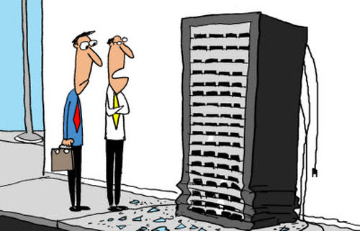
What is Bioinformatics?
Good question! Well, basically the use of computer to aid in the investigation of biological questions.
Biological … : Medicine, agriculture, environmental … life etc …
Requires:
Substantial computational resources
Inter-discipline expertise
Collaboration …

Slide 3
Why the boom in Bioinformatics: Cost of sequencing = MORE DATA!
Genomics, my specialist area of bioinformatics is heavily based on the “sequencing” of DNA and or RNA…
Data science = machine learning and artificial intelligence.
This has massively changed over the past 15 years. More later … but the point here is on the 2 next slides!

Slide 4
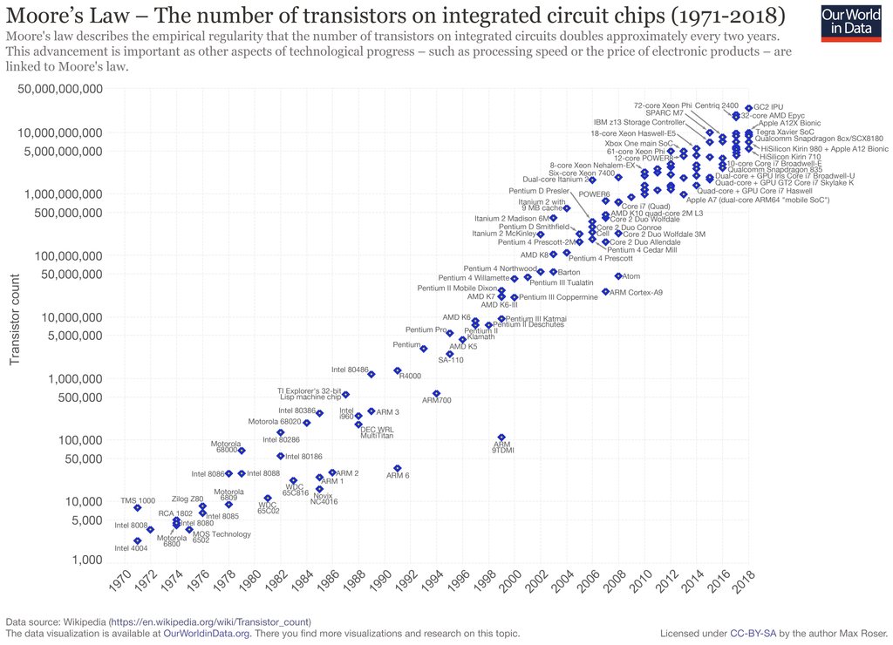

Slide 5
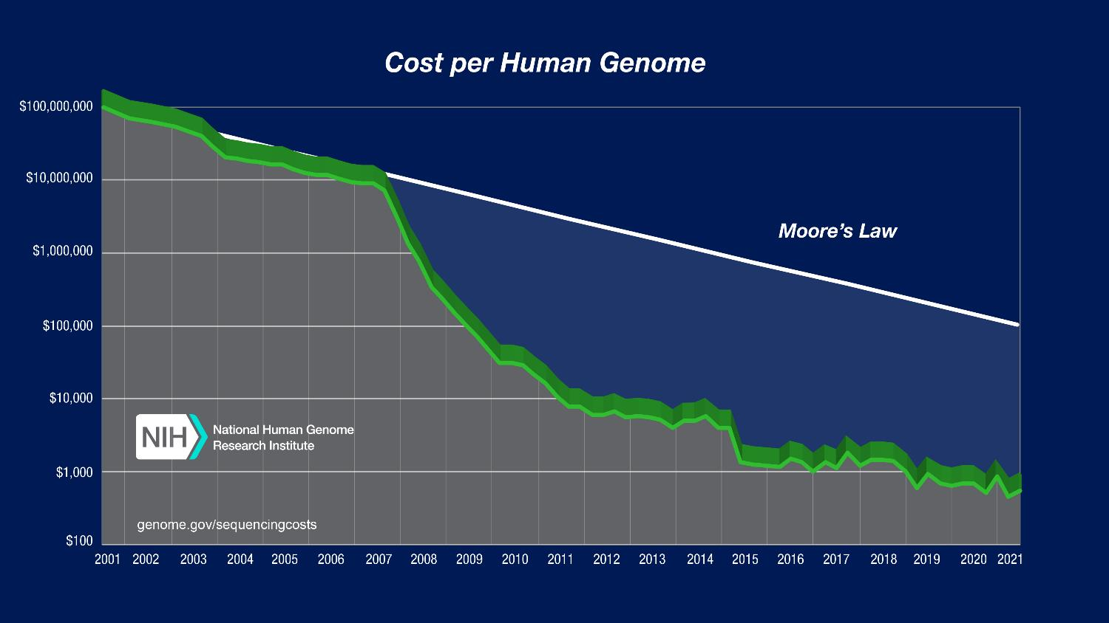
Cost of sequencing
The new Illumina Novaseq can produce 16Tb of data per run!!
Now $300 per human genome
https://www.genome.gov/about-genomics/fact-sheets/Sequencing-Human-Genome-cost
As you can see from the graph, the cost has far out paced computers (Moore’s law) – oh dear! - this kind of matters …

Slide 6

Cost of sequencing
The new Illumina Novaseq can produce 16Tb of data per run!!
Now $300 per human genome
Sanger
NGS, or 2nd generation
Third gen, sort of
https://www.genome.gov/about-genomics/fact-sheets/Sequencing-Human-Genome-cost
As you can see from the graph, the cost has far out paced computers (Moore’s law) – oh dear! - this kind of matters …

Slide 7
Computational resources + human
Increasing data <-> advancements of the sequencing technology.
You cannot do this on a laptop or a single computer:
Storage: Huge storage and back up capacity. (Peta bytes)
RAM: Some application require huge amounts of RAM (random access memory, not to be confused with storage), for example 3TB (plant genomes).
CPUs: Fast and numerous processors.
GPUs: Increasingly needed for applications.
Linux: Linux high performance computing cluster!! – essential.
Sys Admin (human): Someone to manage the system called a Sys Administrator. This is a difficult and skilled job.

Slide 8
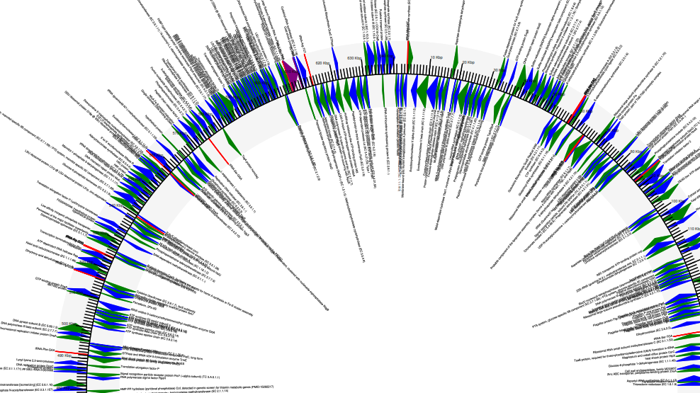
Interdisciplinary expertise:
Bioinformatician
Due to increasing volumes of data, and the essential need to use Linux HPC the following skills are needed:
Program: shell, python and R (others are a bonus too) to control the computer
Statistics: essential due to the nature of comparing large and numerous data sets.
Biological knowledge: Being able to critically evaluate the results in a biology context (or chemistry if applicable).
Organisms: virus, plants, animals, fungal - all kingdoms.
Historically these skills are not taught together, so the Bioinformatician will have to learn.

Slide 9
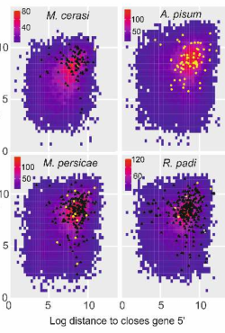
Bioinformatician: Collaboration
Bioinformatics is a very diverse field:
Proteomics, structural, genomics, transcriptomics, phylogenetics, single cell, binding dynamics, machine learning and artificial intelligence - to list a few.
“learn” all these fields? Therefore, to get the most reliable and reproducible results it is essential to collaborate with experts in these areas.
Bioinformatics evolves and moves forward rapidly!

Slide 10
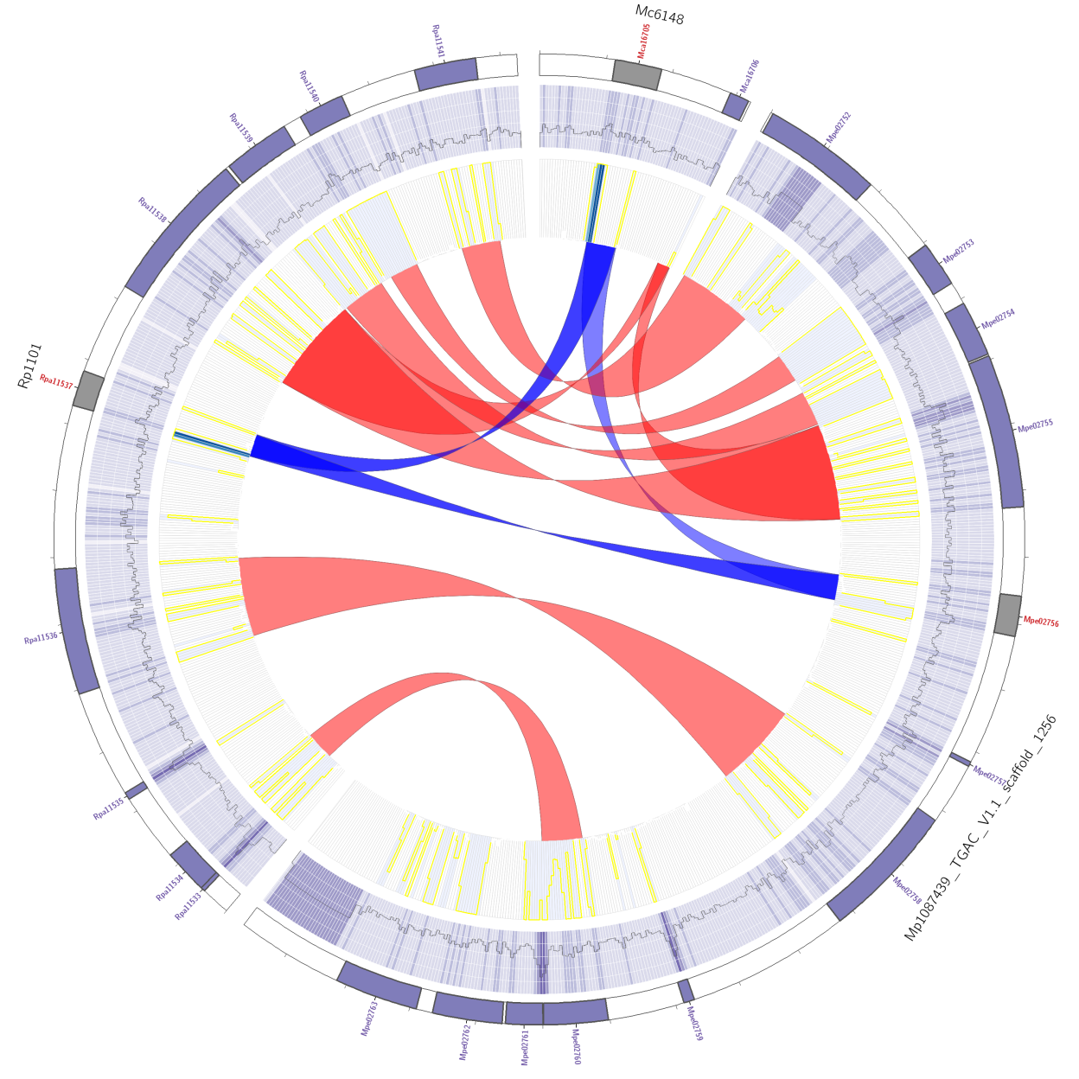
Constantly Evolving
Bioinformatics as a discipline is moving forward very fast.
New technologies produces different and better data – seem to be released every ~3 months.
According to Intel: Bioinformatics is growing as a market faster than the finance market (personal communication).
New software is constantly being released
Keep up – good luck!!

Slide 11
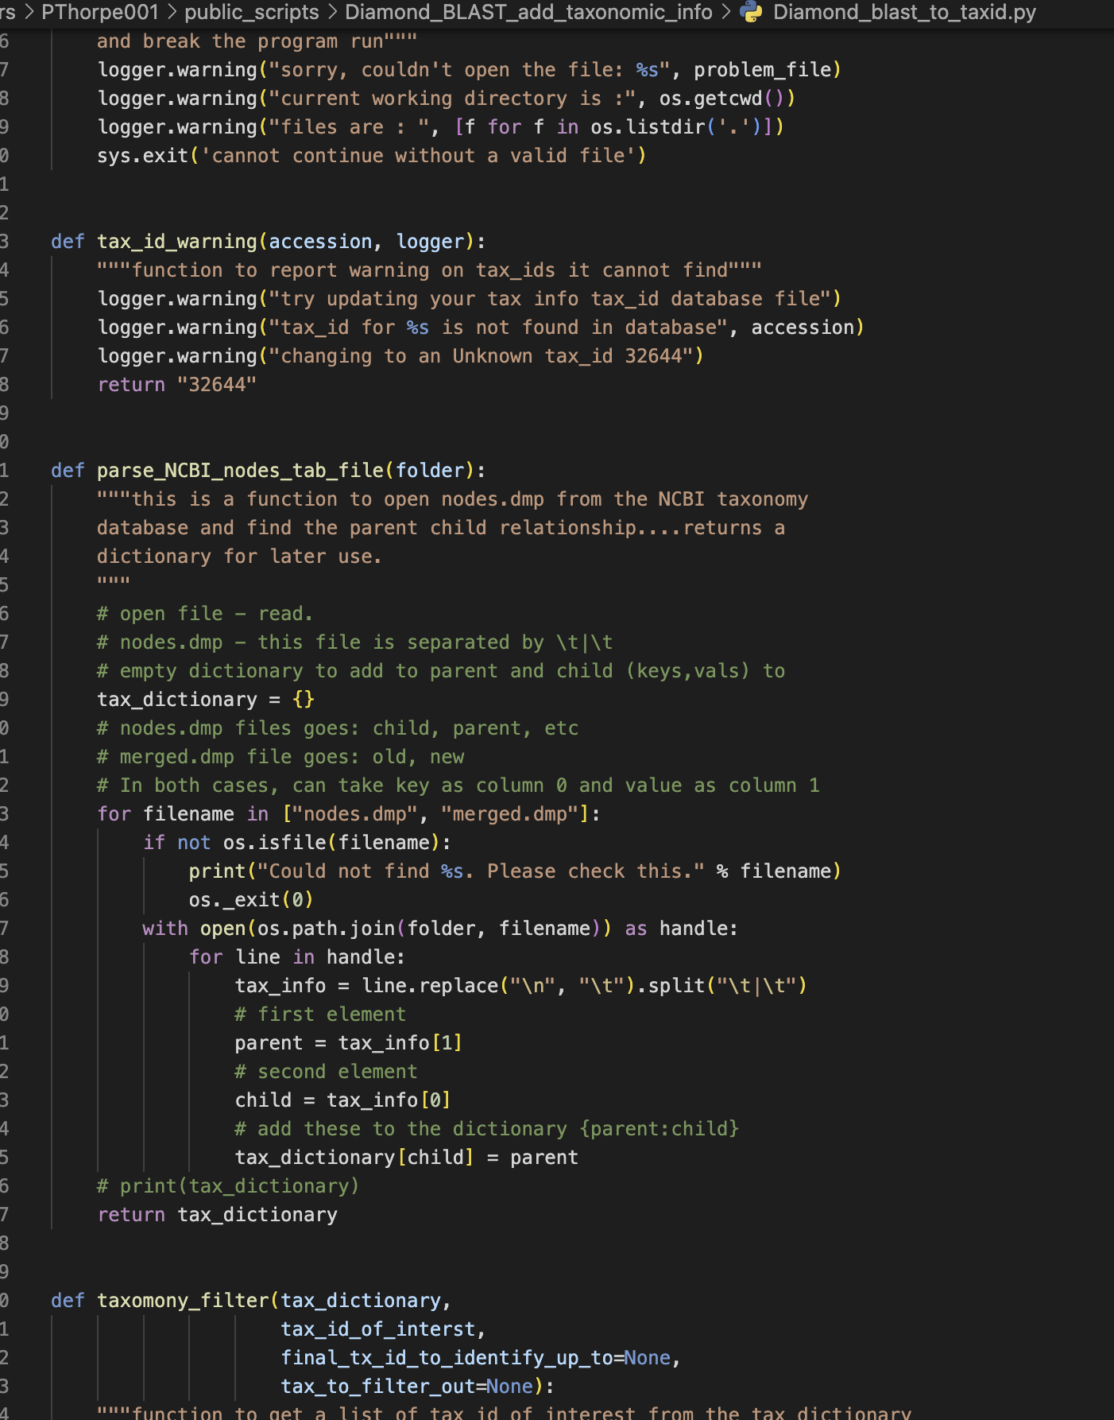
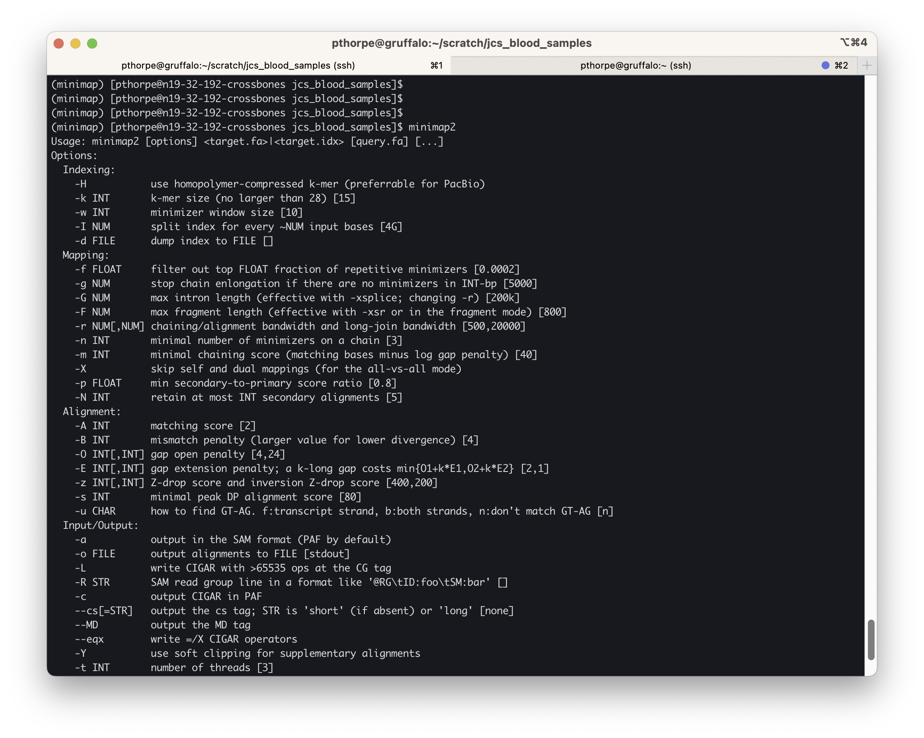
Bioinformatic analysis
Command line tools: terminal.
Coding: Or development of your own software (or just scripts) in a suitable language. For example Python, R and/ shell.
Reproducibility: is mandatory. Therefore, version control and availability of code via github is recommended.
Experimental design: before project start is essential.
Python script or software
Command line tool

Slide 12
What would be required for a Bioinformatics group
High performance computing cluster (HPC) : Access to a HPC (with a sys admin) that meets the requirements of the data type
Could use Amazon Web Services or similar to avoid the initial costs and sys admin costs.
Bioinformaticians: A team of Bioinformatician with a wide range of expertise to help each other grow and develop, and also to be able to do the projects required of them.
Collaboration: A wider network to collaborate with.

Slide 13
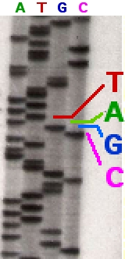
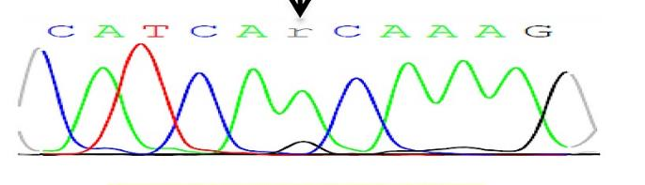
A little background Genomics data: History of sequencing
https://en.wikipedia.org/wiki/Sanger_sequencing
Radio labelled bases were run on gels an manually interpreted for the order of the bases. Years to complete a gene https://agctsequencing.wordpress.com/2012/08/01/sanger-sequencing-historical-development-of-automated-dna-sequencing
Sanger sequencing (~1990s): highly accurate, Very high cost, ~1000bp reads.
https://plos.figshare.com/articles/figure/_Images_of_Sanger_sequencing_electropherogram_showing_novel_mutations_left_panel_detected_in_the_study_cohort_reverse_direction_and_the_corresponding_wild_type_sequence_right_panel_of_normal_tissue_sections_for_the_same_patient_indicating_the_somatic_orig/1248566/1

Slide 14
History of sequencing
Sanger sequencing: It is still used today for cloning, as the cost per sample ~£3. (for the human genome ~$300million, although final cost $2.7 billion):
454/ Solexa/ Ion Torant (~2006): pyrosequencing technology, relatively expensive totally discontinued.
Illumina (2002 – present): (Next Generation Seq: NGS). Massive reduction in cost per Giga base. Huge coverage, still used heavily today! Short reads. 2 X 50 – 250bp. (today <$300 to sequence the human genome).
Third Generation Sequencing Technology: Nanopore (used heavily during the COVID pandemic), PacBio … Both can produce very long reads, both companies lie ;) about the read quality (indels due to homopolymers). - can detect methylated DNA bases too… (post translational modifications)

Slide 15
Cost per sequencing method
Nanopore, PacBio and Illumina regularly release upgrade and new chemistries that improve these figure all the time.
 | Sanger | Illumina HiSeq2500 | PacBio | Nanopore
Read Length | ~1000bp | 2 X (50 - 250)bp | 10 - 35 kb | up to 1.6 million
Yield | 80 kb | 500Gb | 10Gb | ~2Gb
Price per Gb | £1 million | $30 | $125 | $750
Update: Illumina Novaseq X plus now output 16TB!!! $2 per gigabyte
$40 has been suggested
Fatima, N., Petri, A., Gyllensten, U., Feuk, L. and Ameur, A., 2020. Evaluation of single-molecule sequencing technologies for structural variant detection in two swedish human genomes. Genes, 11(12), p.1444.
Li, Changsheng & Lin, Feng & An, Dong & Wang, Wenqin & Huang, Ruidong. (2017). Genome Sequencing and Assembly by Long Reads in Plants. Genes. 9. 6. 10.3390/genes9010006. –( some values altered from this to reflect the past few years. )

Slide 16
Pros and cons of seq technology
Sanger sequencing: Expensive – SUPER accurate. Used for checking cloning constructs, one sample at a time
Illumina: Cheap, accurate, but SHORT reads (~300bp). No indels. Some known errors/ biases. Data is well known and tools exists and are “mature”.
Used for projects with many samples, metabarcoding, RNAseq, polishing TGS genome assemblies, genotyping … many many applications
Can multiplex more samples than TGS due to pair end lib prep
Huge coverage!!
Third Generation Sequencing (TGS) Technology: Nanopore PacBio …
BIG advantage, very long reads.
BIG problem indels (discuss why)
Used for everything – but you need to know its limitations.
Less coverage

Slide 17
History assembly methods
The reads from Sanger sequencing were subjected to assembly via overlap consensus using programs such as cap3
Great just keep putting them on top of each other (cannot resolve repeat > 1000bp. Coverage is poor due to cost.
https://www.ncbi.nlm.nih.gov/pmc/articles/PMC310812/
A real example using Cap3

Slide 18
History of sequencing
Sanger: over lap consensus assembly. This is ok for Sanger data
…. Buuuuuut Illumina comes along. You now have 500Gb (16TB?)
100 years to assemble: It would take the fastest computing cluster on earth to assemble a genome using overlap consensus with Illumina data
….. What to do …????? Kmers and de bruin graphs. We wont talk about that now. But things change fast, computers and methods lag behind

Slide 19
Reading (just get an overview… wide range here)
Bachtiar, M., Ooi, B.N.S., Wang, J., Jin, Y., Tan, T.W., Chong, S.S. and Lee, C.G., 2019. Towards precision medicine: interrogating the human genome to identify drug pathways associated with potentially functional, population-differentiated polymorphisms. The pharmacogenomics journal, 19(6), pp.516-527.
Quigley, K.M., Bay, L.K. and van Oppen, M.J., 2020. Genome‐wide SNP analysis reveals an increase in adaptive genetic variation through selective breeding of coral. Molecular Ecology, 29(12), pp.2176-2188.
The genome and lifestage-specific transcriptomes of a plant-parasitic nematode and its host reveal susceptibility genes involved in trans-kingdom synthesis of vitamin B5 https://www.biorxiv.org/content/10.1101/2021.10.01.462558v1
Li, L., Liu, X., Wei, K., Lu, Y. and Jiang, W., 2019. Synthetic biology approaches for chromosomal integration of genes and pathways in industrial microbial systems. Biotechnology advances, 37(5), pp.730-745.
Zhang, X., Rayner, J.G., Blaxter, M. and Bailey, N.W., 2021. Rapid parallel adaptation despite gene flow in silent crickets. Nature Communications, 12(1), pp.1-15.
Eising, E., Mirza-Schreiber, N., de Zeeuw, E.L., Wang, C.A., Truong, D.T., Allegrini, A.G., Shapland, C.Y., Zhu, G., Wigg, K.G., Gerritse, M.L. and Molz, B., 2022. Genome-wide analyses of individual differences in quantitatively assessed reading-and language-related skills in up to 34,000 people. Proceedings of the National Academy of Sciences, 119(35), p.e2202764119.
Hill, C.B., Angessa, T.T., Zhang, X.Q., Chen, K., Zhou, G., Tan, C., Wang, P., Westcott, S. and Li, C., 2021. A global barley panel revealing genomic signatures of breeding in modern Australian cultivars. The Plant Journal, 106(2), pp.419-434.
Nakagawa, H. and Fujita, M., 2018. Whole genome sequencing analysis for cancer genomics and precision medicine. Cancer science, 109(3), pp.513-522.
Chiu, C.Y. and Miller, S.A., 2019. Clinical metagenomics. Nature Reviews Genetics, 20(6), pp.341-355.
Wensel, C.R., Pluznick, J.L., Salzberg, S.L. and Sears, C.L., 2022. Next-generation sequencing: insights to advance clinical investigations of the microbiome. Journal of Clinical Investigation, 132(7), p.e154944.

Slide 20
RNAseq: The analysis of the transcriptome
This is a large part of what I have historically done and has revolutionised biology.
The ability to quantify the whole transcriptome at any sampled time point/ treatment and compare against others.
Idealy a mix of NGS and TGS for this: Coverage and the long reads

Slide 21


RNAseq: What is differential expression
RNAseq: The sequencing of the transcriptome (RNA, mRNA, miRNA, shRNA)
To use a obvious example: If eyes were dissected out of human heads, sequenced and compared to the sequencing output of the liver. You would expect to find eye specific gene expression in one sample and liver specific expression in the other. (plus some genes that are the same “housekeeping” genes)
If an Exact test was applied to such data you would find gene significantly upregulated in one sample versus the other.
vs

Slide 22
Application of RNAseq data: lot more than just these
Differential expression between conditions (or groups of)
Cancer cell line/ patient: Haplotyping of HLA alleles (current project): Szolek, A., Schubert, B., Mohr, C., Sturm, M., Feldhahn, M. and Kohlbacher, O., 2014. OptiType: precision HLA typing from next-generation sequencing data. Bioinformatics, 30(23), pp.3310-3316.
TSS: Liu, Y., Han, D., Han, Y., Yan, Z., Xie, B., Li, J., Qiao, N., Hu, H., Khaitovich, P., Gao, Y. and Han, J.D.J., 2011. Ab initio identification of transcription start sites in the Rhesus macaque genome by histone modification and RNA-Seq. Nucleic acids research, 39(4), pp.1408-1418.
Gene fusions (cancer): Heyer, E.E., Deveson, I.W., Wooi, D., Selinger, C.I., Lyons, R.J., Hayes, V.M., O’Toole, S.A., Ballinger, M.L., Gill, D., Thomas, D.M. and Mercer, T.R., 2019. Diagnosis of fusion genes using targeted RNA sequencing. Nature communications, 10(1), pp.1-12.
SNP calling: Identifying gene with greater SNP per base frequency. Pokhare, S.S., Thorpe, P., Hedley, P., Morris, J., Habash, S.S., Elashry, A., Eves‐van den Akker, S., Grundler, F.M. and Jones, J.T., 2020. Signatures of adaptation to a monocot host in the plant‐parasitic cyst nematode Heterodera sacchari. The Plant Journal, 103(4), pp.1263-1274.
Single cell RNAseq: Arzalluz-Luque, Á. and Conesa, A., 2018. Single-cell RNAseq for the study of isoforms—how is that possible?. Genome biology, 19(1), p.110.

Slide 23
Projects at St Andrews to date
Type | data type | Organism | PI | purpose
Exome sequencing | Illumina | Human | Silvia Paracchini | corolate variantes with disease phenotype
Genome assembly | Illumina, PacBio, nanopore | Fish (4 species), fly, Malaria, crickets, nematodes | Ritchie, Cox-S, Bailey, Jones | population genomics/ gene flow/ sex determination
R gene identification | Nanopore | potato | John Jones | disease breeding
Metabarcoding | Illumina | Nematode | John Jones | species identification
RNAseq | Illumina, nanopore | Chicken, nematodes, C. elegans, bacteria, Amphioxus, mouse, fish, flies, human (cancer) | Paracchini, Jones, Ferreira, Holden, Somorjai, Mansley, Ritchie, Harrison | Numerous. Drugs transcriptional changes in humans.
Cancer: HLA genotyping | Illumina | Human | Simon Powis | genotype patients who had cancer.
COVID19 | Illumina and Nanopore | Virus | Simon Powis | Vaccine development, preliminary work.
Comparative genomics | Illumina | Human, bats, mouse | Sonja Vernes | Numerous
Public health | Safe haven data | Antibiotic resistance | Virginia/ Colin | Corrolations of AMR with population statistics
cancer biomarkers | Nanopore | Human cancer cell lines | Paul Reynolds | personalised medicine
21 projects
lots of sequencing data types and organisms.

Slide 24
Example projects: Collaboration with Dr Janet Cox Singh University of St Andrews

Slide 25
Nanopore sequencing of DNA extracted from monkey blood to identify potential parasites
DNA extracted -> sequenced using long read sequencer Nanopore
Metagenomic assembly: Remove “the host reads”. Assemble and taxonomically classify the assembled contigs to identify what was “there”. (Flye, Kraken)
Mapping alternative: create a database with Plasmodium and “other” species. Map to this to identify what may be there.
.. New technology and new methods. The process is still be refined.
Janet to discuss the result.

Slide 26
Nanopore sequencing of DNA extracted from monkey blood to identify potential parasites
Why was it difficult: Map error prone reads? What does the mapper do
Hard mask repetitive regions: What does the mapper do here?
Does it really pick the best mapping region(??)
NCBI database is known to contain errors… How to prove and check??
As for the metagenomic full approach:
REFSEQ used. Missing many species
Genomes mis-classified? (in NCBI)
Metagenomic assembly method needs a min coverage to “assemble” a region – if not it is thrown away.
The assembly method has a polishing phase – surely this is a bad this? Would get a consensus assembly. Not wanted!!
Taxonomic classification is thought to be currently of low accuracy (Janet – paper??)

Slide 27
Example projects 1: Globodera pallida genome assembly (nematode) – John Jones School of Biology University of St Andrews

Slide 28
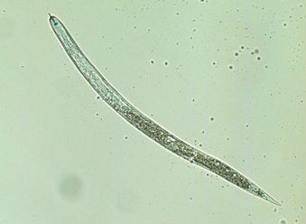
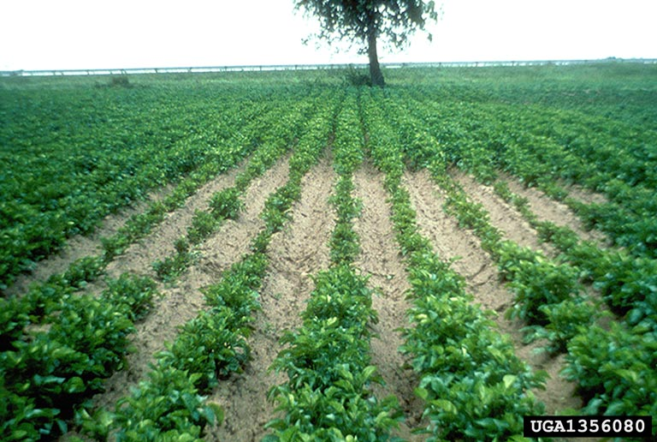
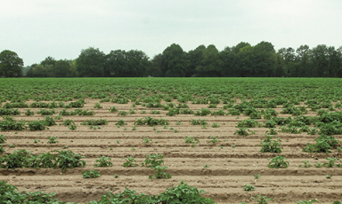
Globodera pallida (Newton) PacBio assembly

Slide 29
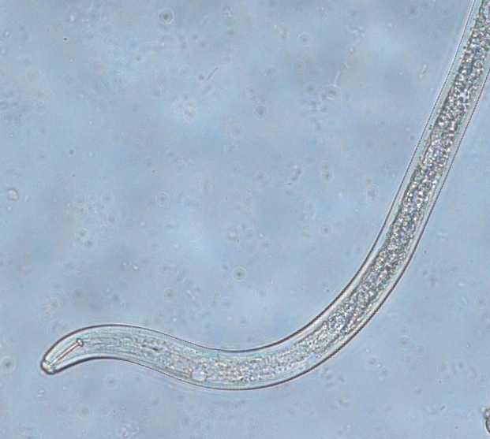
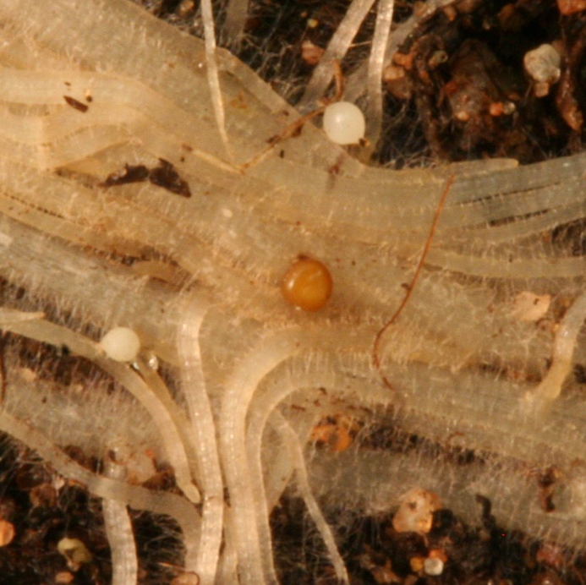
Intro: Potato cyst nematode
Huge amounts of damage/ yield loss.
Can live as cysts for decades
EU banning lots of nematicides.
… genome: alternative control targets.

Slide 30
The data: PacBio
PacBio (Long read technology)
Pacific Biosciences Sequel instrument using Sequel Polymerase v2.1, SMRT cells v2 LR and Sequencing chemistry v2.1.
New enzyme (April 2018), double read length double the output

Slide 31
Final assembly: Very difficult process …
Final contig assembly: Wtdbg2 -> Improver.py -> remove contamination(Blobtools) -> Purge haplotypes A=80 (strict).
Scaffold: sspace-longread (more strict parameters than default). GapFill.
Polishing: Arrow (X3) and Pilon (X5). Polishing with Illumina data helps correct the indels in long read data.
Haplotype phase: using Whatshapp.

Slide 32
Filenames | Gp_Newton_haplotype1.fasta | published Gpal.v1.0.fas
LongestScaffold | 8,303,752 | 600,076
Num | 163 | 6873
Span (flow cyto: 106 -113 mb haploid) | 119,630,711 | 124,672,549
N50 | 2,289,110 | 121,687
NumN50 (9 haploid chromosomes) | 14 | 298
GC | 0.365 | 0.367
For contigs longer than 100 bp (scaffolds split at >= 10 Ns):
LongestContig | 7,341,856 | 93,564
Num | 664 | 18414
Span | 118,387,716 | 103,648,320
N50 | 613,406 | 11,611
NumN50 | 38 | 2448
GC | 0.365 | 0.367
For runs of Ns (>= 10 Ns):
Num | 505 | 12000
Span | 1,243,042 | 21,024,229
N50 | 4107 | 4467
BUSCO
Representing: | C:89%[D:9.9%],F:5.9%,M:4.6%,n:303 | C:73%[D:13%],F:12%,M:14%,n:303
complete C
duplicated (D) | 271 | 222
fragmented (F) | 30 | 41
missing (M) | 18 | 38
total searched | 14 | 43
 | 303 | 303
RNAseq mapping
Number of input reads: 159126633
UNIQUELY MAPPED READS: | 85.90% | 68.91%
MULTI-MAPPING READS: | 6.38 | 7.38%
UNMAPPED READS: | 7.03% | 23.44%
Metrics for the scaffolds.
Never trust anyone who hides the contig level assembly metrics.

Slide 33
Filenames | Gp_Newton_haplotype1.fasta | published Gpal.v1.0.fas
LongestScaffold | 8,303,752 | 600,076
Num | 163 | 6873
Span (flow cyto: 106 -113 mb haploid) | 119,630,711 | 124,672,549
N50 | 2,289,110 | 121,687
NumN50 (9 haploid chromosomes) | 14 | 298
GC | 0.365 | 0.367
For contigs longer than 100 bp (scaffolds split at >= 10 Ns):
LongestContig | 7,341,856 | 93,564
Num | 664 | 18414
Span | 118,387,716 | 103,648,320
N50 | 613,406 | 11,611
NumN50 | 38 | 2448
GC | 0.365 | 0.367
For runs of Ns (>= 10 Ns):
Num | 505 | 12000
Span | 1,243,042 | 21,024,229
N50 | 4107 | 4467
BUSCO
Representing: | C:89%[D:9.9%],F:5.9%,M:4.6%,n:303 | C:73%[D:13%],F:12%,M:14%,n:303
complete C
duplicated (D) | 271 | 222
fragmented (F) | 30 | 41
missing (M) | 18 | 38
total searched | 14 | 43
 | 303 | 303
RNAseq mapping
Number of input reads: 159126633
UNIQUELY MAPPED READS: | 85.90% | 68.91%
MULTI-MAPPING READS: | 6.38 | 7.38%
UNMAPPED READS: | 7.03% | 23.44%
Ok, so you can see that the contigs are good.
Much reduced NNN occurrence….
What about more evidence of the quality of the assembly?

Slide 34
Filenames | Gp_Newton_haplotype1.fasta | published Gpal.v1.0.fas
LongestScaffold | 8,303,752 | 600,076
Num | 163 | 6873
Span (flow cyto: 106 -113 mb haploid) | 119,630,711 | 124,672,549
N50 | 2,289,110 | 121,687
NumN50 (9 haploid chromosomes) | 14 | 298
GC | 0.365 | 0.367
For contigs longer than 100 bp (scaffolds split at >= 10 Ns):
LongestContig | 7,341,856 | 93,564
Num | 664 | 18414
Span | 118,387,716 | 103,648,320
N50 | 613,406 | 11,611
NumN50 | 38 | 2448
GC | 0.365 | 0.367
For runs of Ns (>= 10 Ns):
Num | 505 | 12000
Span | 1,243,042 | 21,024,229
N50 | 4107 | 4467
BUSCO
Representing: | C:89%[D:9.9%],F:5.9%,M:4.6%,n:303 | C:73%[D:13%],F:12%,M:14%,n:303
complete C | 271 | 222
duplicated (D) | 30 | 41
fragmented (F) | 18 | 38
missing (M) | 14 | 43
total searched | 303 | 303
RNAseq mapping
Number of input reads: 159126633
UNIQUELY MAPPED READS: | 85.90% | 68.91%
MULTI-MAPPING READS: | 6.38 | 7.38%
UNMAPPED READS: | 7.03% | 23.44%

Slide 35
Contamination removed: Before metric produced above.
This is relevant to the contamination bit I was rambling about yesterday

Slide 36
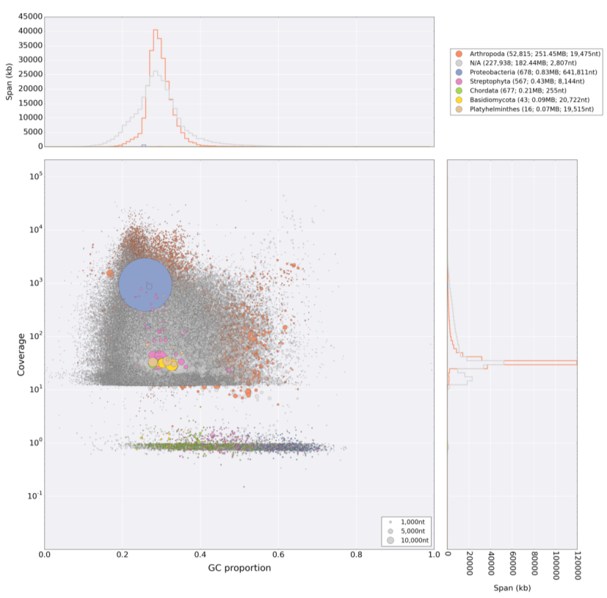
Contamination example
MUST NOT assembly contaminants!!!!!!!!!!!!!!!
THIS IS not CLEAN
This is relevant to the contamination bit I was rambling about yesterday

Slide 37
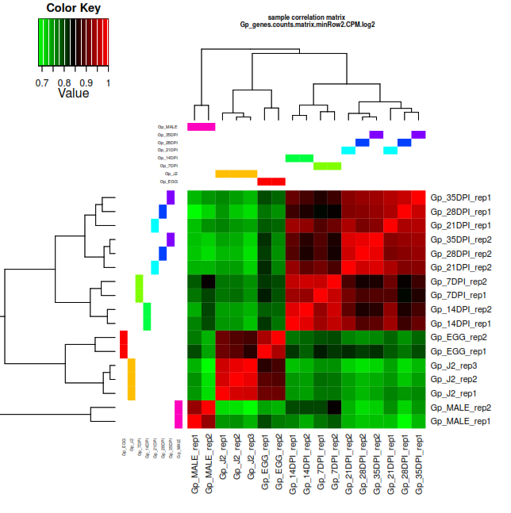
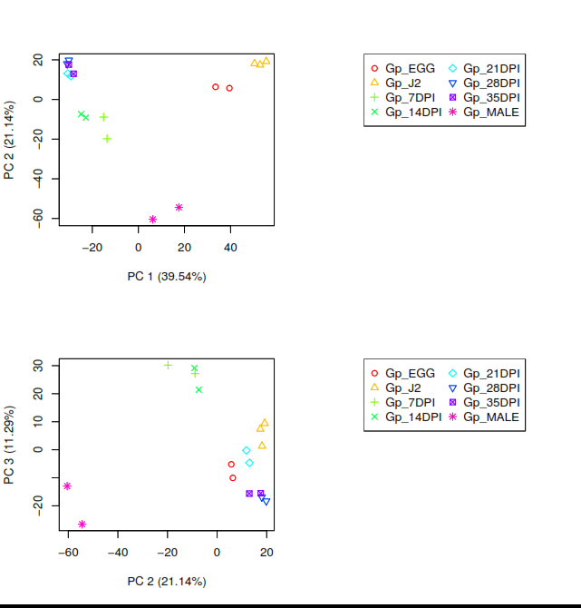
DE analysis: RNAseq from complete life cycle
RNAseq conditions cluster together, as they should.

Slide 38
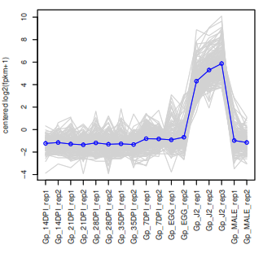
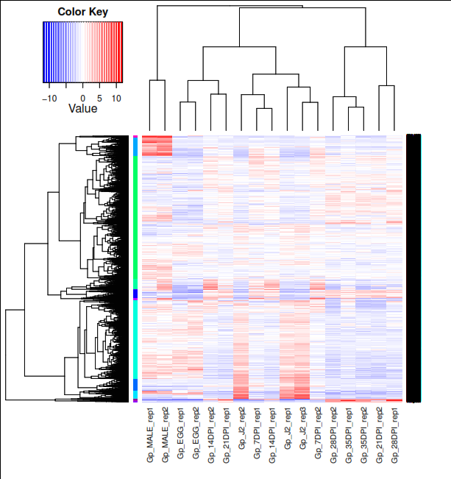
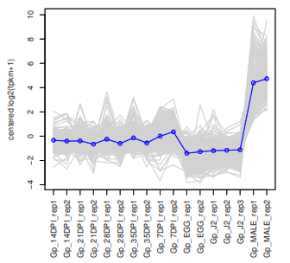
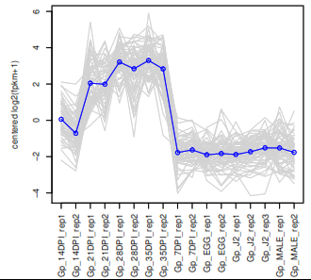
DE analysis different life stages: LOG2 FDR p<0.001
Genes of interest
 | Gp_14DPI | Gp_21DPI | Gp_28DPI | Gp_35DPI | Gp_7DPI | Gp_EGG | Gp_J2 | Gp_MALE
Gp_14DPI | 0 | 441 | 544 | 555 | 172 | 2576 | 4029 | 2125
Gp_21DPI | 441 | 0 | 32 | 46 | 395 | 1512 | 3457 | 1761
Gp_28DPI | 544 | 32 | 0 | 0 | 559 | 1143 | 3224 | 1608
Gp_35DPI | 555 | 46 | 0 | 0 | 534 | 1265 | 3398 | 1598
Gp_7DPI | 172 | 395 | 559 | 534 | 0 | 2036 | 3806 | 1628
Gp_EGG | 2576 | 1512 | 1143 | 1265 | 2036 | 0 | 1161 | 1439
Gp_J2 | 4029 | 3457 | 3224 | 3398 | 3806 | 1161 | 0 | 2860
Gp_MALE | 2125 | 1761 | 1608 | 1598 | 1628 | 1439 | 2860 | 0

Slide 39
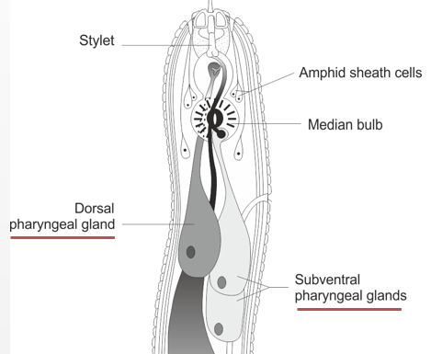
Examples: Globodera rostochiensis, Effector promoter/enhancer
Nematode effectors and genomes
There must be some regulatory motif which controls tissue specific expression
To find the “effector promoter”:
1) Training set (Non-exhaustive list of known effectors) Experimentally verified – Time consuming!!
2) Positive test set (another genome from different species)
3) Negative test set (another genome from different species)
Intestine

Slide 40
Examples: Globodera rostochiensis, effector promoter/ regulatory motif
Search upstream of every effector
Compare promoter region:
Dorsal gland effectors VS Random non-effectors
75% of training set (avg 3.5/promoter)
DOrsal Gland box
(DOG box)
DOG box will occur by random, so multiple copies is the key

Slide 41
Examples: Globodera rostochiensis, effector promoter motif
Search upstream of every gene
Training species
+ve test species
-ve test species
Number of motifs per sequence
Number of motifs per sequence
Frequen cy dist number of sequences with number of motifs per sequence
For 3 species
The number of promoters with multiple dog boxes significantly deviates from random

Slide 42
Examples: Globodera rostochiensis, motif – new effectors, confirmation by in situ hybridisation
Confirmation by in situ hybridisation
Take the top subset:
5 or more DOG boxes
Signal peptide
No TM domain
We re-identify loads of known effectors
gene 2 g04707
gene 1 g14226
Focus only on novel genes - validate the prediction of gland cell expression by in situ hybridisation?.
We have predicted DOG effectors from available genome sequences

Slide 43
Examples: Globodera rostochiensis, transcription factor that binds the motif?
Can a TF be found?
If so, this could be a better “target” for biotechnology than individual effectors or effector families …
Interfere with the TF that regulate 150 effectors – control the pest/ pathogen?

Slide 44

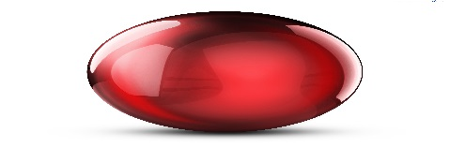
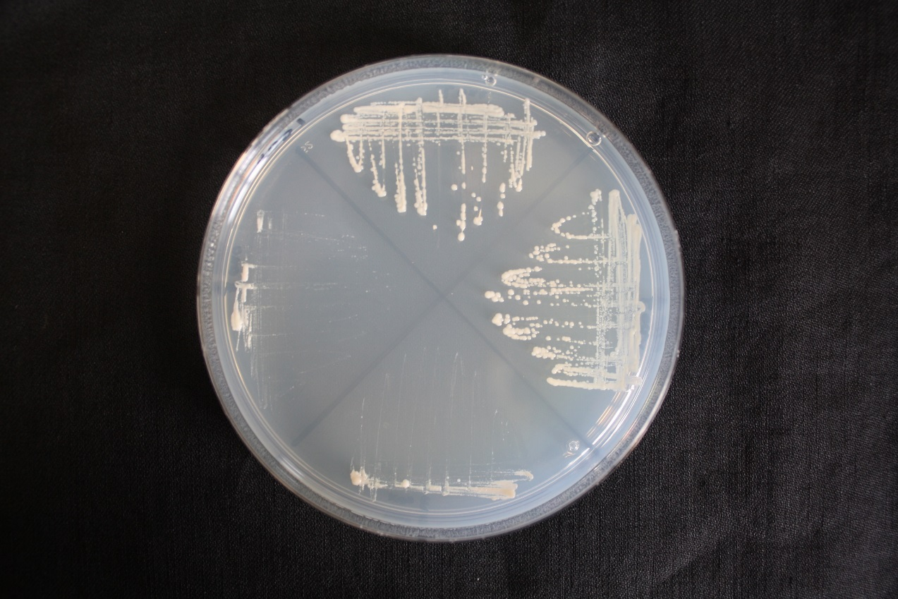
Examples: Globodera rostochiensis, TF that binds the DOG motif? DOGMA
The search for DOGMR
Candidate transcription factor which binds to the DOG box identified
Evidence DOG motif is required for binding
Mutated DOG motif = NO binding
TF a better target for control?
GAD
DOGMR
GAD
DOGMR
+
+
Dr Sebastian Eves van den Akker (University of Cambridge)

Slide 45
SPRYsecs: lots more than we thought..
Shown to be important in nematode host interaction.
New assembly: 455 SPRY, 77 SPRYSECS
G. pallida

Slide 46
Example projects 2: Aphid genome assemblies and RNAseq to identify effector genes.

Slide 47
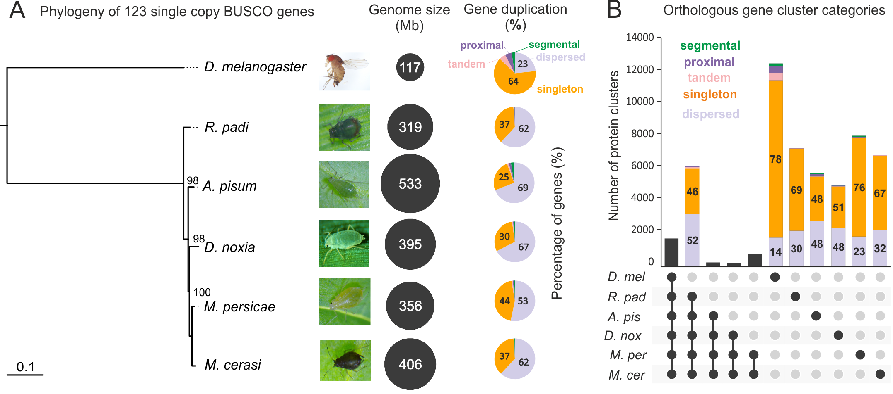
Aphid genome highly repetitive and duplicated. Lots of species specific genes

Slide 48
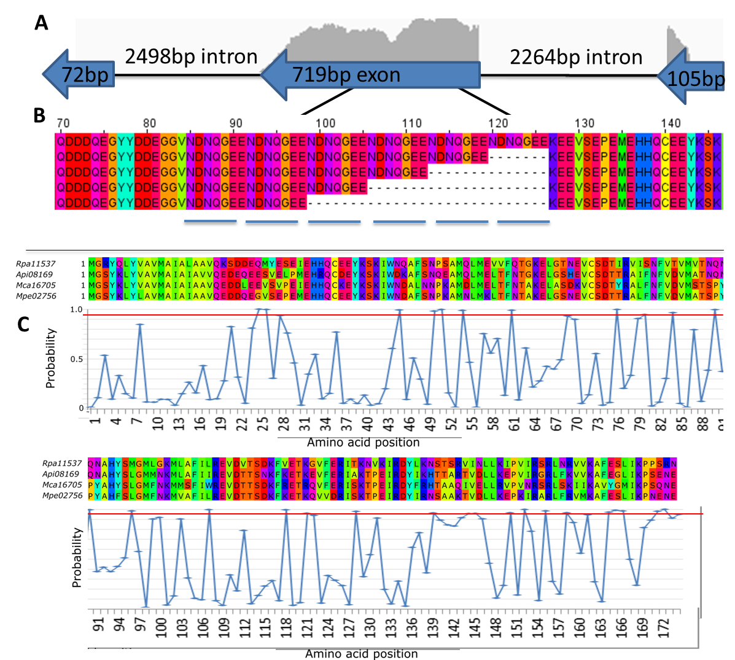
C002 under selection pressure. Repeat variants
Repeat coded in 2nd exon.
DN/DS: 2.35 (selection pressure)
250
310
Sites most likely to be under positive selection (P>0.95) located above red line

Slide 49
Aphid effectors in gene sparse regions.
Distance to next gene greater than non-effectors.
Distance to transposons closer than non-effectors.
No stand out effectors promoter motif identified.
… However, 2 effectors tightly linked by expression

Slide 50
Example projects 3: Plant health testing via water sampling and metabarcoding to identify Phytophthora diversity

Slide 51
Climate change: Tracking Phytophthora
Climate changes the “ecological niche” for pathogens
Therefore pathogens which live in such conditions in other countries could become successful in these new conditions in the UK
We want to identify Phytophthora at a species levels
Current Aim: Improve sampling technique and software to analyse data! Faster, more accurate identification from field to computer
Notes:
We are interested in widening this for two reasons – looking for new threats and knowing more about pathogen ecology in natural ecosystems. Fits recommendations of the UK plant pathgen TASK FORCE in relation to predicting monitoring and controlling spread of these damaging group of pathogens

Slide 52
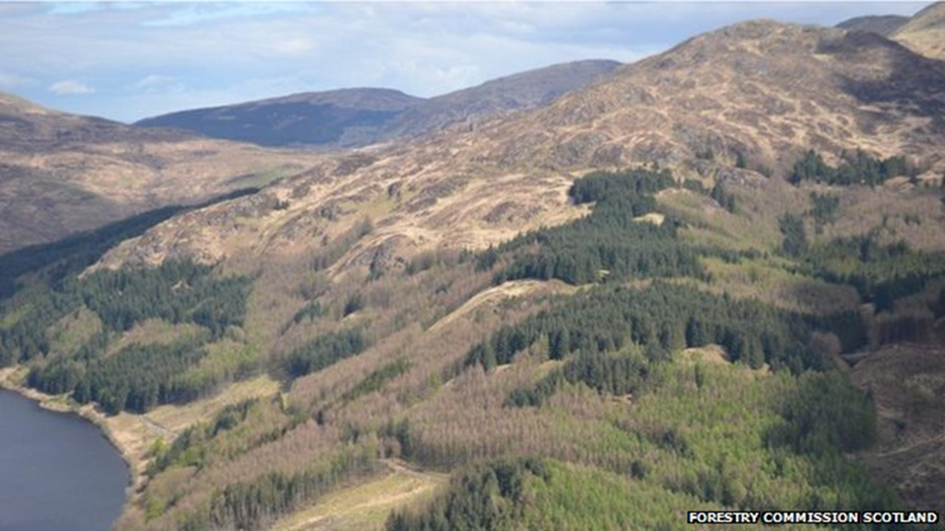
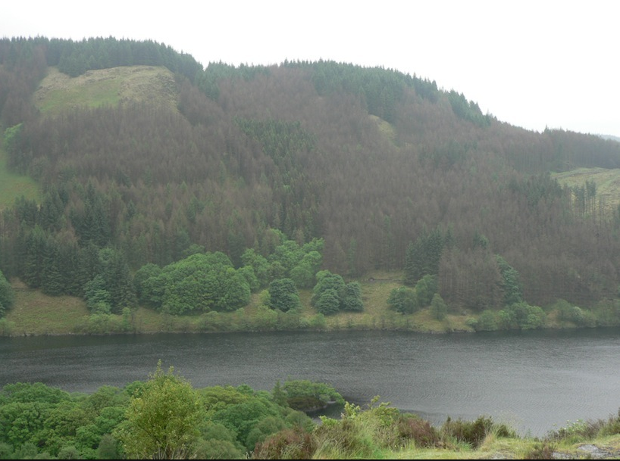
WHY? Landscape scale disease spread - larch

Slide 53
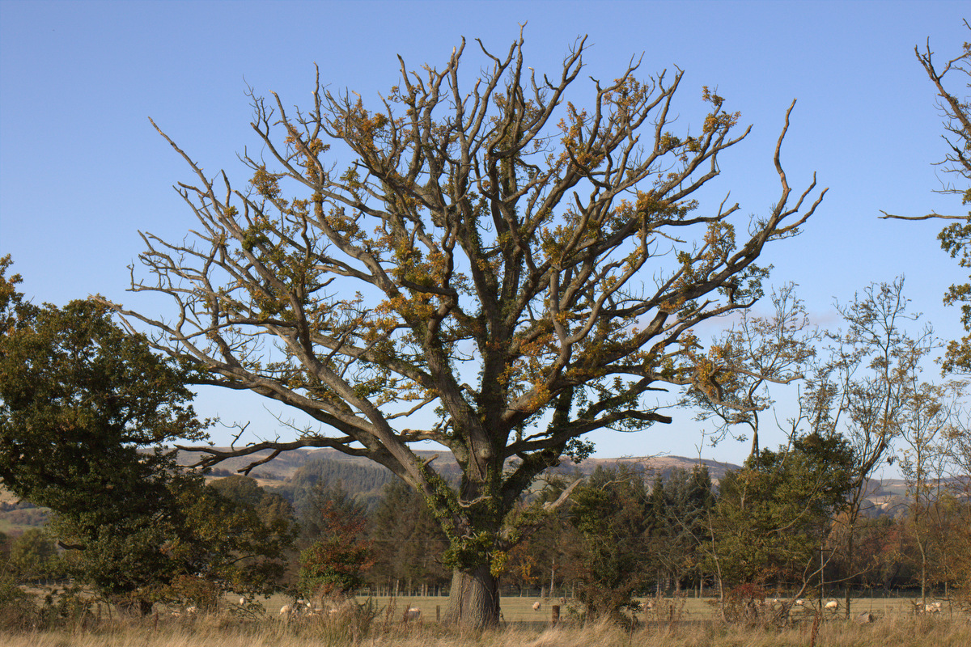
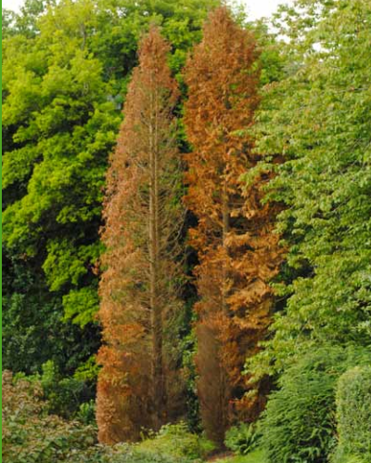
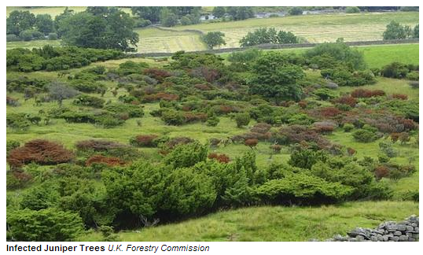
P. austrocedrae
P. lateralis – now in Europe on Lawsons cypress
P. quercina – oak decline
P. ramorum – west coast

Slide 54
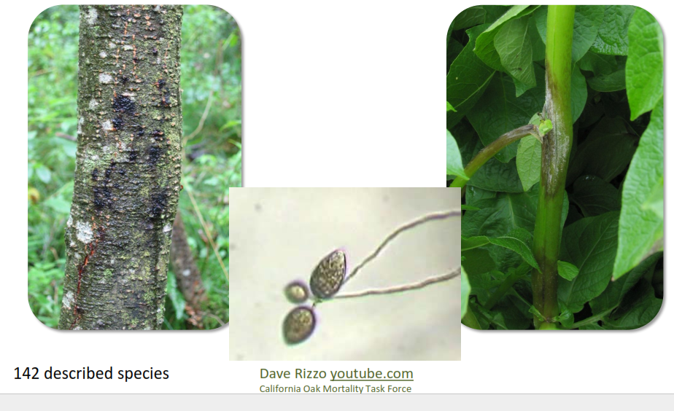
Climate change: Tracking Phytophthora
142 described species
Notes:
We are interested in widening this for two reasons – looking for new threats and knowing more about pathogen ecology in natural ecosystems. Fits recommendations of the UK plant pathgen TASK FORCE in relation to predicting monitoring and controlling spread of these damaging group of pathogens

Slide 55
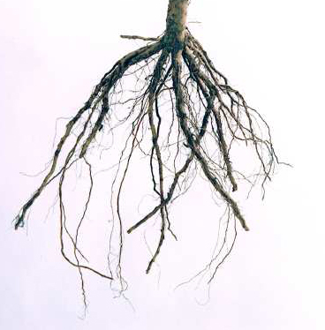
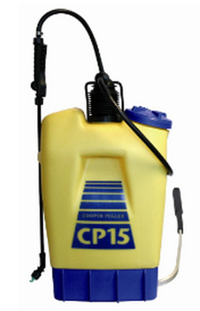
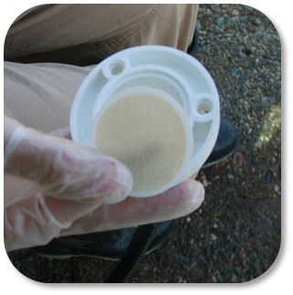
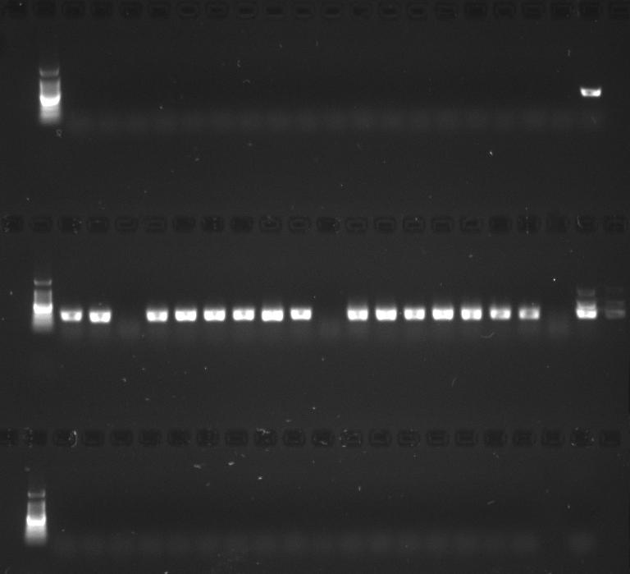
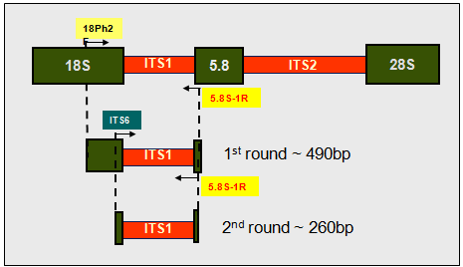
Metabarcode method
1) Collect ->
2) DNA extraction ->
5) Bioinformatic analysis
4) Identify (+ve): send for Illumina
3) Nested PCR: Amplify Phytophthora ITS1
METAPY

Slide 56
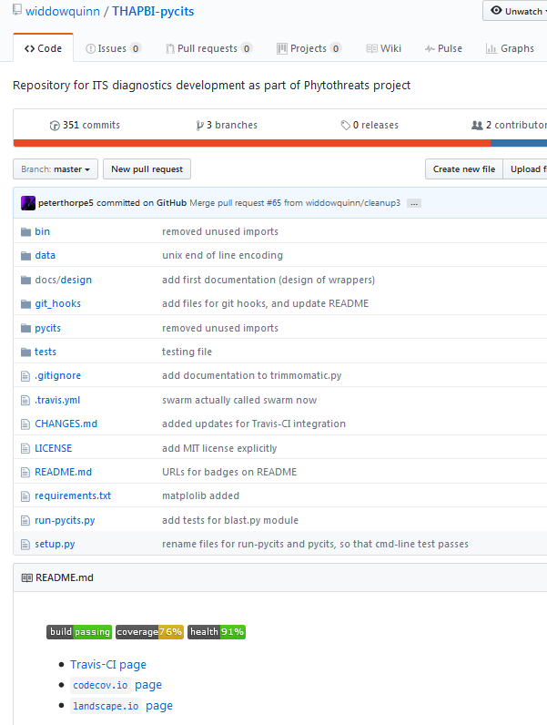
METAPY
Identify species based on a given database of sequences
Travis testing: Software engineering testing framework
Codecov, Pep8 – Code quality measure
Test coverage 76%, health 91%
https://github.com/widdowquinn/THAPBI-pycits

Slide 57
Method
Tool
DNA extraction/ PCR
Nested PCR
DNAseq
Illumina overlapping read
QC, Trim, Chimera detection
Fastqc, Trimmomatic, Vsearch
Error correction ???:
Bayes Hammer
Assemble reads
Flash / PEAR
Convert FQ, FA
Biopython
Trim primers off seq
Python
Cluster
Swarm
CD-HIT
Vsearch
Bowtie
Blastclust
Compare clustering
Graphics
Python: sklearn
Summarise species
Python

Slide 58
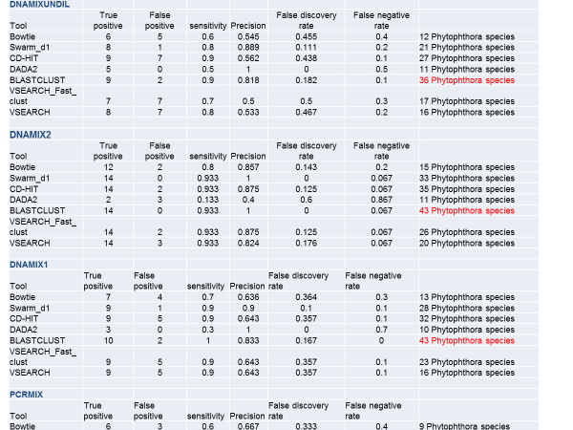
How well did the tools do?? In short every tool = different results. It is not straight forward!! We used this to classify many datasets and advise on government policy.
Notes:
We are interested in widening this for two reasons – looking for new threats and knowing more about pathogen ecology in natural ecosystems. Fits recommendations of the UK plant pathgen TASK FORCE in relation to predicting monitoring and controlling spread of these damaging group of pathogens

Slide 59
Conclusion
Bioinformatics is a fast moving multi-discipline and very diverse research area.
It requires good infrastructure investments, or a cloud based solution.
Requires a team to flourish.
This is the present and future of biology based research. Don’t get left behind.

Slide 60
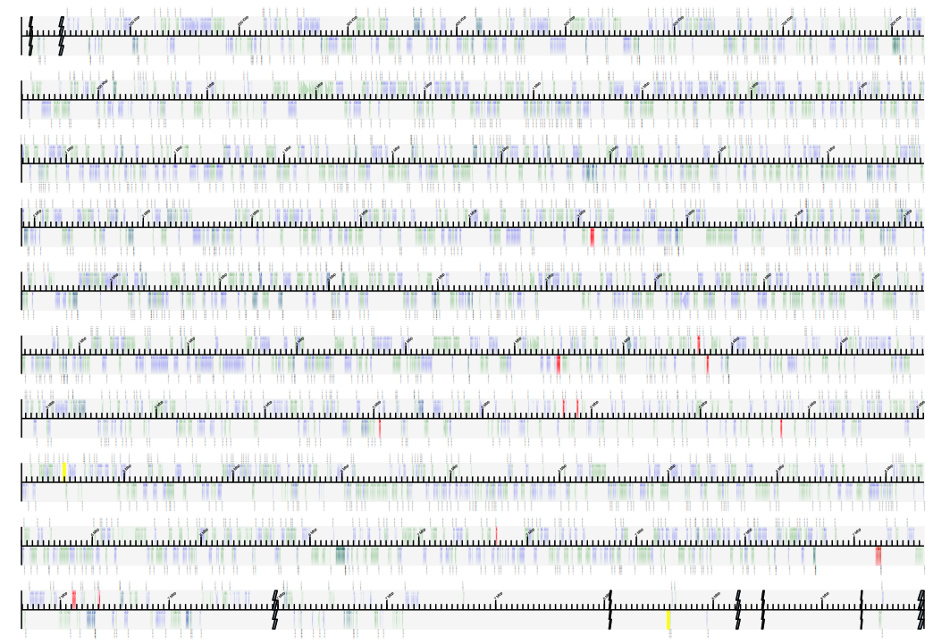
Acknowledgements
So many collaborators:
Janet Cox-Singh lab
John Jones lab
Seb Eves Van den Aker lab
Silvia Parachini lab
Mike Ritchie lab
Jorunn Bos lab
Nathan Bailey lab
Simon Powis lab
David Cooke lab
The data analysis group U of Dundee
……..

